Slide 1
Capstone Project
Presented By Group - eShield
Rajiv, Chintan & Hardik

Slide 2
Objective
eshield
Logistic Regression
Random Forest (concerned/not concerned)
Market Basket
Data Visualization
Support Vector Machine (SVM) (concerned/not concerned)

Slide 3
Objective
Random Forest
To analyze the characteristics of individuals susceptible to falling victim to online transaction fraud.

Slide 4
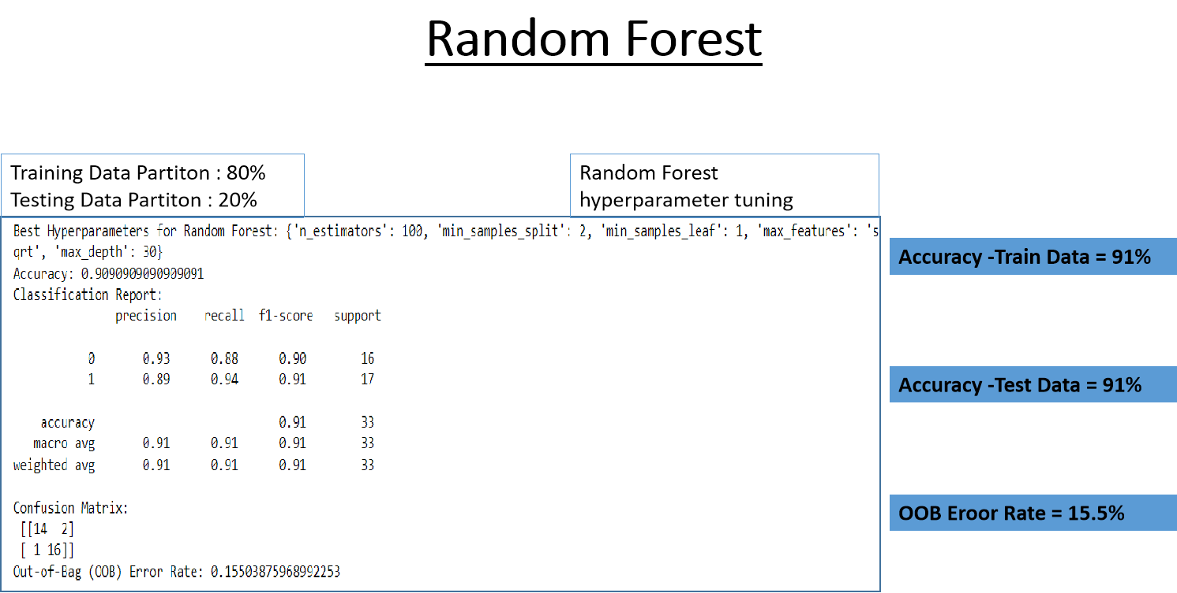
Random Forest

Slide 5
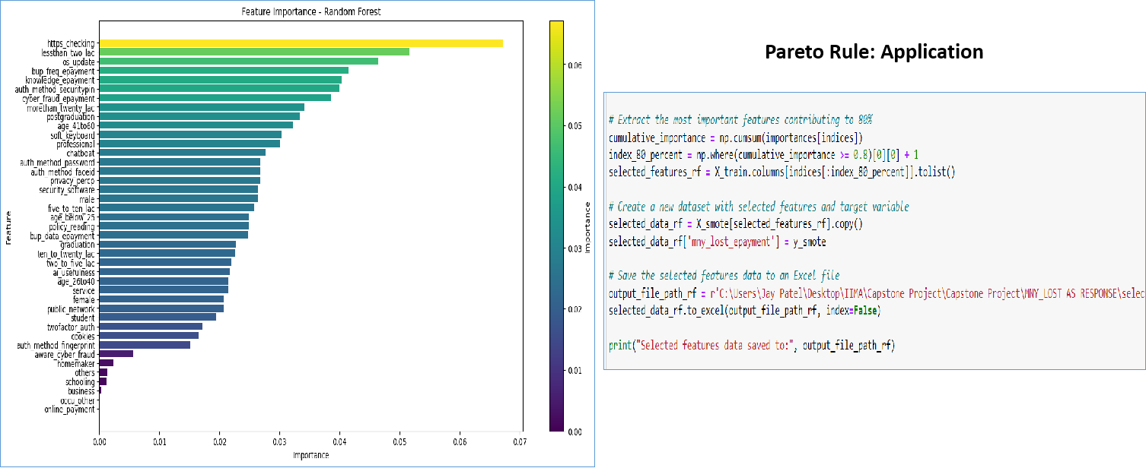
Random Forest
Important
Features
Pareto Rule
Application

Slide 6
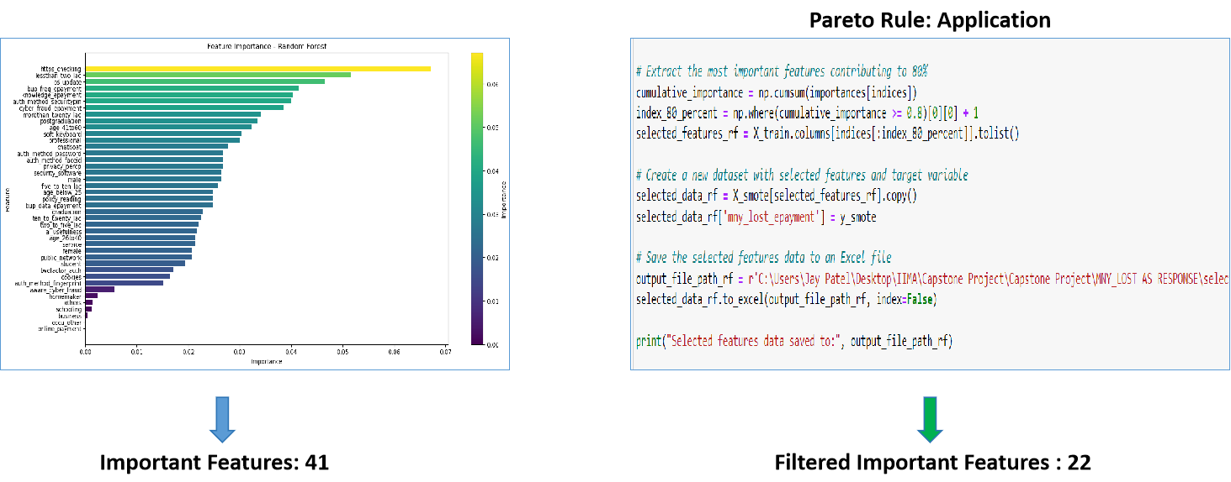
Important
Features
Pareto Rule
Application
Final Filtered
Features

Slide 7
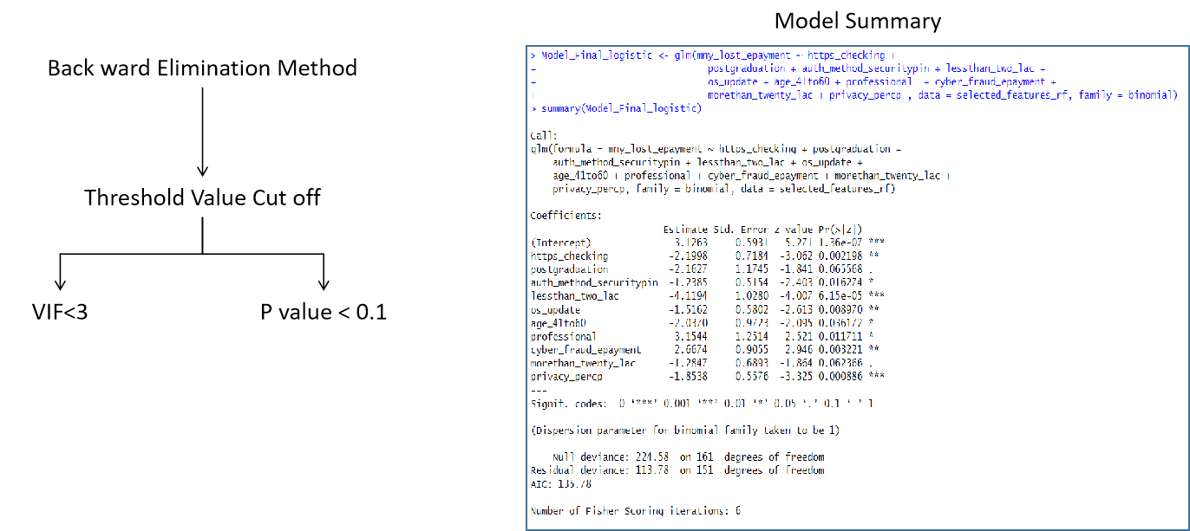
Logistic
Regression
Back ward
Elimination
Final Model
Summary

Slide 8
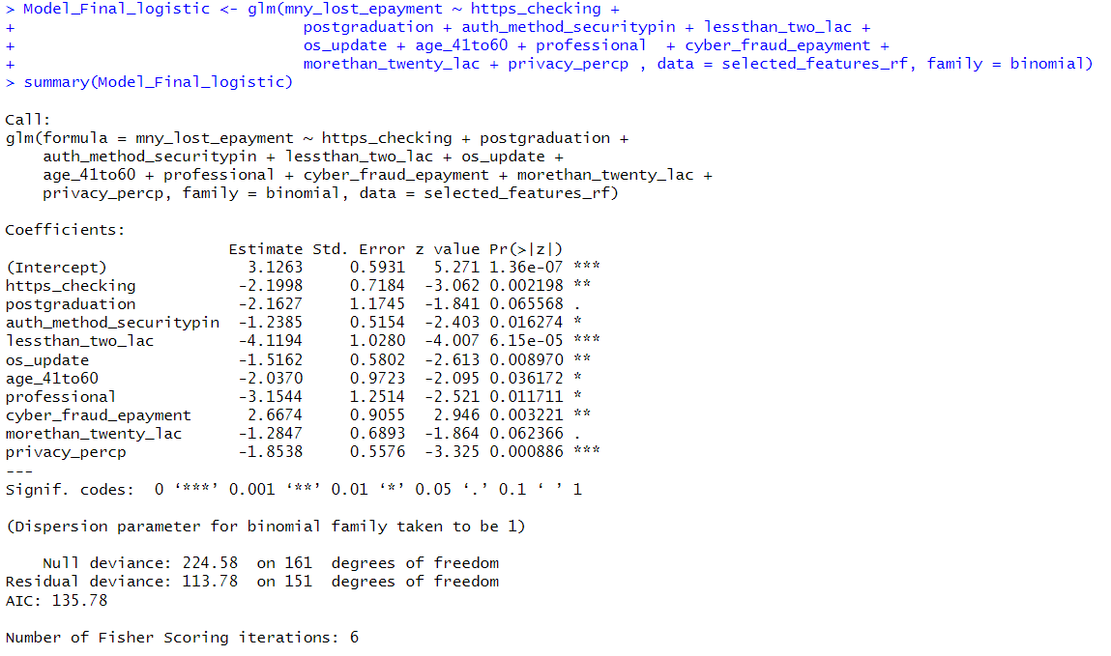
Logistic
Regression
Back ward
Elimination
Final Model
Summary
Significant Variables
10

Slide 9
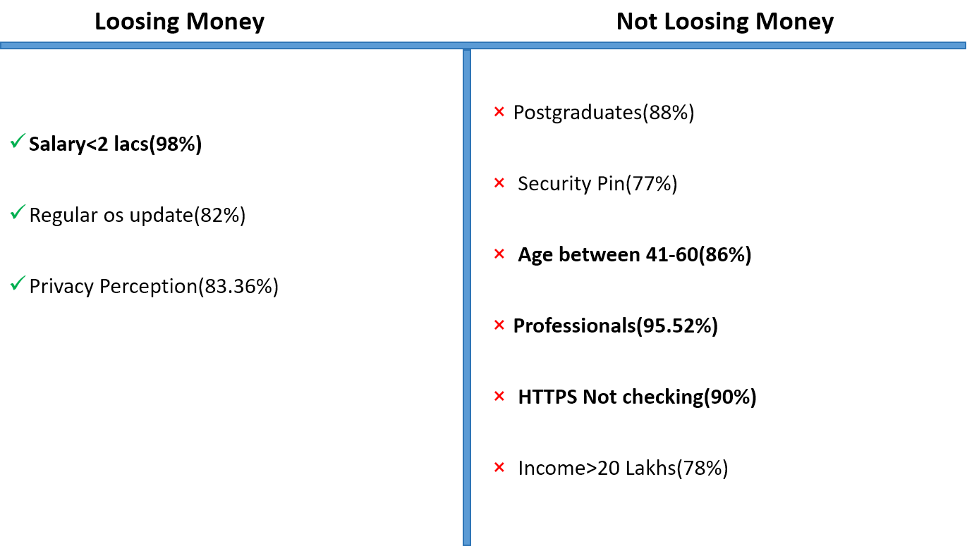
Conclusion

Slide 10
Project Methodology
Design a survey to collect data on e-services usage during digital payments, online purchases, online learning platforms and demographic data of respondents such as sex, age, profession, etc.
Apply data pre-processing: normalize variables, remove noise, and ensure data integrity
Explanatory variables: sex, age, profession , type of e-services, extent of cyber security threat, frequency of transactions, merchant type
Response variables: using of online services (Yes/No), safety perception (Likert scale)
Analyze using simple linear regression: relate age, transaction data to digital payment adoption likelihood
Employ inferential statistics (chi-square tests, t-tests) for relationships between other variables
Regression analysis for demographic impact on adoption and safety perception

Slide 11
Data Collection
Data Collection Through Google Form ( Link is shared below)
https://forms.gle/eidJ1KNXuTGur3NB9
Sample Size : > 100
Target Sample : Students, Working Professionals, House makers , Senior Citizens

Slide 12
Project Time Plan
Data Collection : By 5th Nov
Review and Cleaning of Data: By 7th Nov
Data Analysis : By 10th Nov
Review of Results and Correcting Analysis : By 20th Nov
Final Report and Presentation : By 24th Nov

Slide 13
Data (selected)
Column | Variable
Timestamp | data_collectoin_timestamp
Email Address | email
Do you carry out online monetary transactions? | doing_transaction
Which electronic transaction method do you prefer the most? | transaction_method
Are you aware about cyber fraud in E-payments? | fraud_awareness
How much concerned are you about security on the Internet? | concerned
How often do you update your device’s operating system and applications? | os_update
Do you connect your device with public network? | public_network
Do you have prior knowledge about information security? | information_security_knowledge
Do you keep back-up of your data? | data_backup
If you are having back up of your data then how often do you take back-up of your data? | data_backup_scheule
Do you use any network security software technology to protect your device from attack? | network_security
Have you ever lost money during online transaction? | lost_money
Do you use two-factor authentication when possible? | two_factor
Will you perform online monetary transactions in future? | future_transaction
Name : | name
Contact Number: | contct
Email Address | email
Gender: | gender
Age | age
Education | education
Occupation | occupation
Annual Family Income(in rupees): | income_gropu

Slide 14
Method
Data Collections
Data Normalization
Define Questions for the Data
Exploratory Analysis
Predictive Analysis
Conclusion

Slide 15
Data Normalization
Added dummy columns
Fixed open text data
Removed incomplete data

Slide 16
Define Questions for the Data
Check the Reponses by various factors
Age, Income, Occupation
Check how people are concerned about security on the Internet
Check how much people are aware about possibilities of fraud
Check the patten of who are likely to lose the money in fraud
Define Questions for the Data
Define Questions for the Data

Slide 17
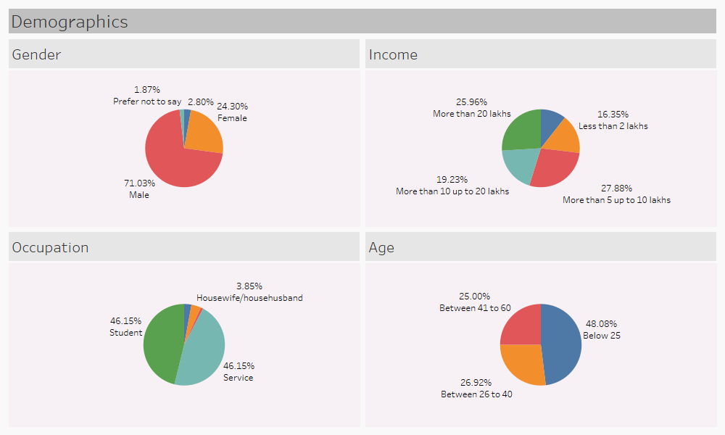
Data Exploration
Define Questions for the Data
Define Questions for the Data

Slide 18
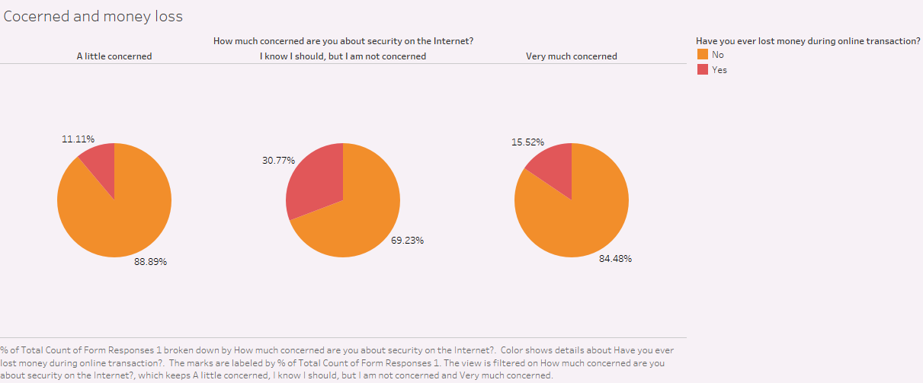
Data Exploration
Define Questions for the Data
Define Questions for the Data

Slide 19
Check concern about Security
Used logistic model on the explanatory variables
Method
library loads
Read Data
Run the Initial Model
first output
Remove singularities
Conclusion
Prediction
ROC Curve and find optimum threshold and optimum prediction-
Choose threshold with max sensitivity code
Define Questions for the Data
Define Questions for the Data
Outcome
With more than 60% accuracy found relationship of the probability of having people more concerned about security as below
=1/(1+EXP(-(5.0151+(-1.7268*age_group)+(-3.5396*is_student))))

Slide 20
Check how much people are aware about possibilities of fraud
Used Market basket analysis Using Language R
information_security_knowledge=No
data_backup=No
two_factor=No
Gender:=Female
The rules suggest a strong association between the specified conditions in the lhs and the absence of fraud awareness (fraud_awareness=No).
Specifically, the rules indicate that when individuals have characteristics such as lack of information security knowledge, no data backup, no two-factor authentication, and are female, they are highly likely to not have fraud awareness.
The rules have high confidence, indicating a strong predictive power for the absence of fraud awareness given the specified conditions.
Define Questions for the Data
Define Questions for the Data

Slide 21
Thank You

